Slide 1
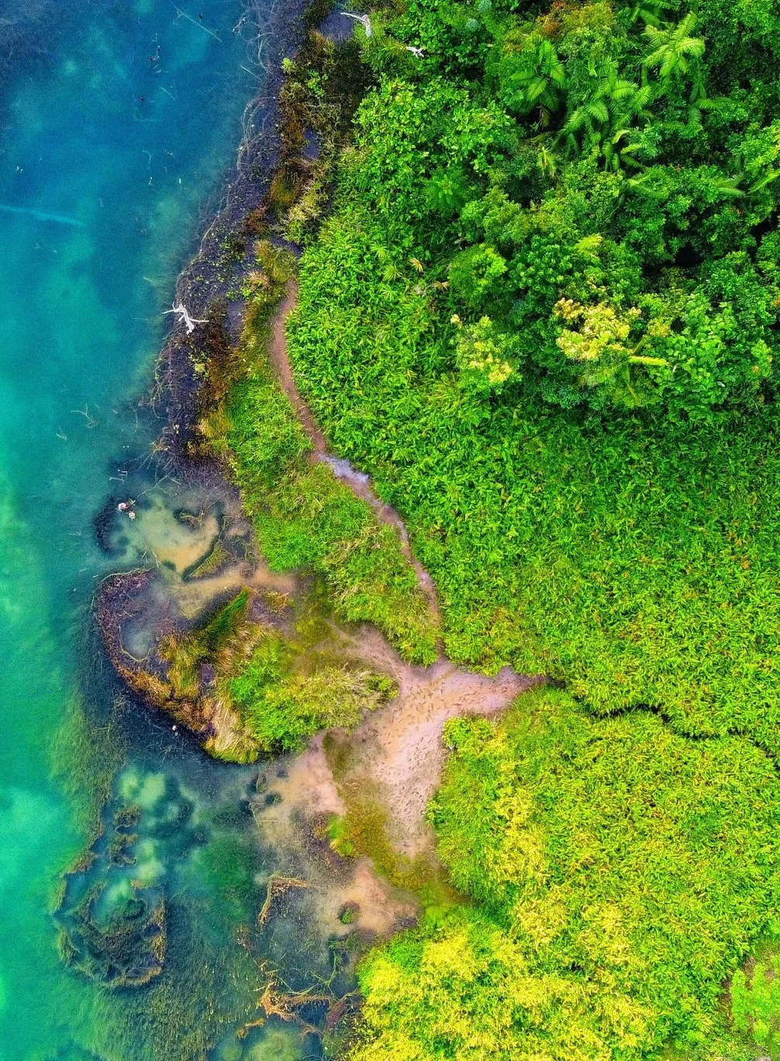
The Main Drivers of Biodiversity Crisis
And How Has Human Activity Restructured Life on Earth?
Zofia Muchowska, Katelyn Keenen, Diana Alvarez Peralta, Matej Dimitrievski, Hesam Owlanj

Slide 2
BIODIVERSITY
1. What is it?
2. What is its role?
3. What is the biodiversity crisis?

Slide 3
What are the main drivers of the biodiversity crisis?

Slide 4
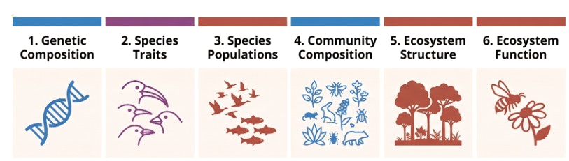
1
DIMENSIONS MONITORED FOR BIODIVERSITY
Essential Biodiversity Variables (EBVs):
Essential Biodiversity Variables (EBVs):
*Infographic generated with Notebook LM. Percentage values verified and sourced from Jaureguiberry et al. The direct drivers of recent Global Anthropogenic Biodiversity loss

Slide 5
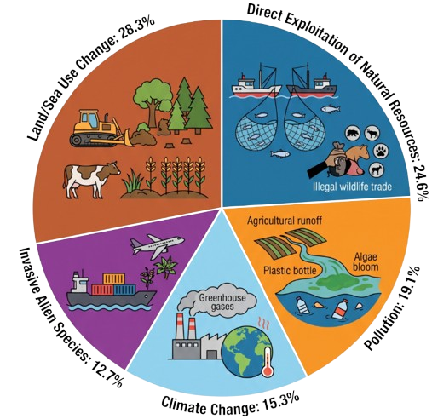
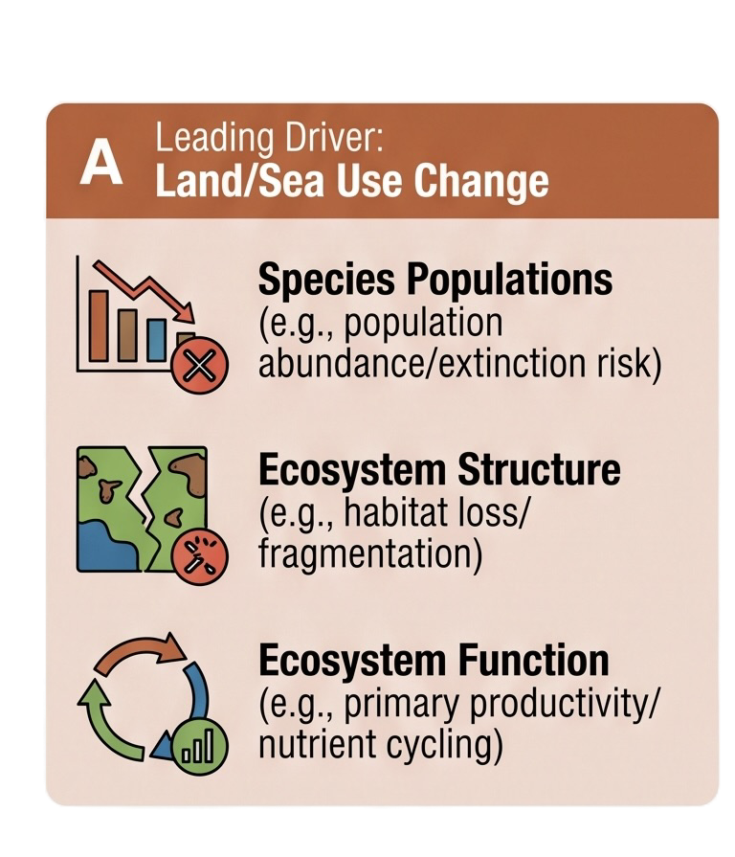
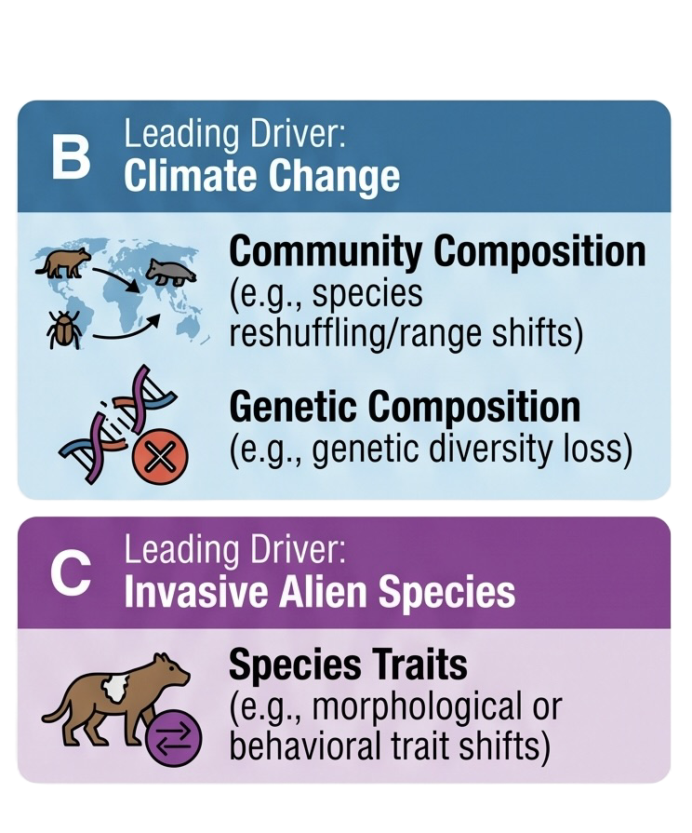
5 Drivers of The Biodiversity Crisis
Values derived from a meta-analysis of 45,162 studies narrowed down to 154 through extensive screening.
*Infographic generated with Notebook LM. Percentage values verified and sourced from the article Jaureguiberry et al. The direct drivers of recent Global Anthropogenic Biodiversity loss

Slide 6
Who is behind these direct drivers?

Slide 7
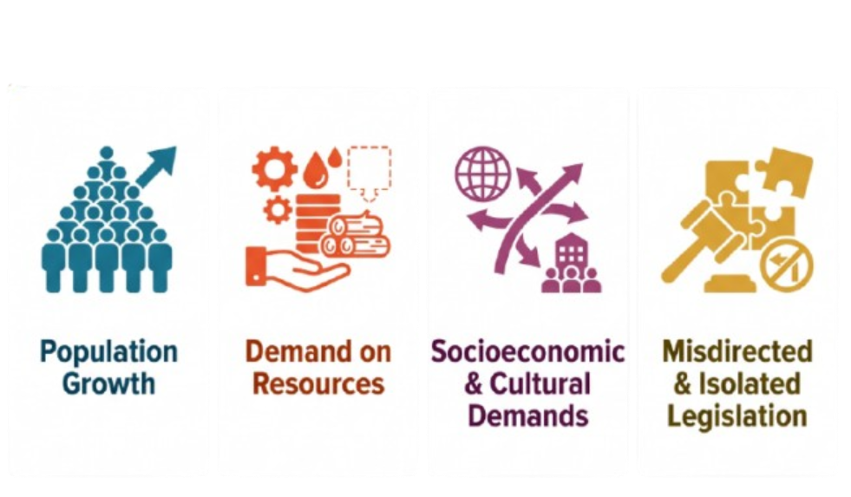
Human Activity:
The Indirect Drivers of Biodiversity Loss
*Infographic generated Notebook LM. Percentage values verified and sourced from Jaureguiberry et al. The direct drivers of recent Global Anthropogenic Biodiversity loss

Slide 8
How are these drivers seen in different regions?

Slide 9
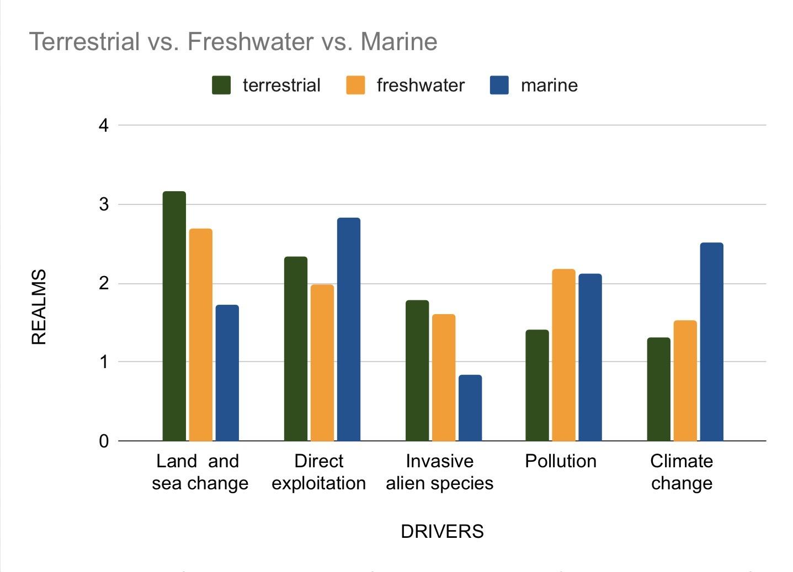
2 DIFFERENCES IN ECOSYSTEMS
HOW DID THE DRIVERS DIFFER IN EACH REALM?
TERRESTRIAL : Land-based environments, eg. forests, grasslands, savannas, deserts and mountains
FRESHWATER: Rivers, lakes, streams, ponds, wetlands and freshwater marshes
MARINE REALMS: Oceans, seas, coral reefs, estuaries, coastal systems
Data extracted from Jaureguiberry, Pedro, et al. “The Direct Drivers of Recent Global Anthropogenic Biodiversity Loss.” Science Advances, vol. 8, no. 45, Nov. 2022.

Slide 10
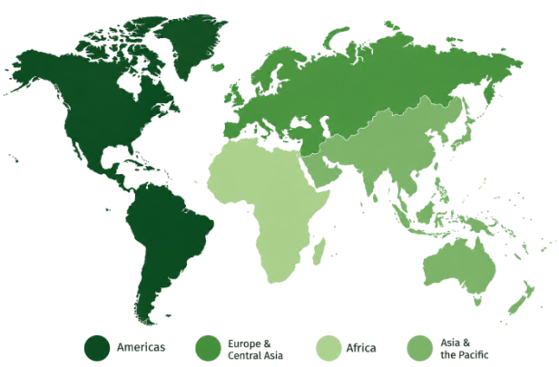
DIFFERENCES IN REGIONS
The Americas
Europe and Central Asia
Africa
Asia and the Pacific
AI-generated image

Slide 11
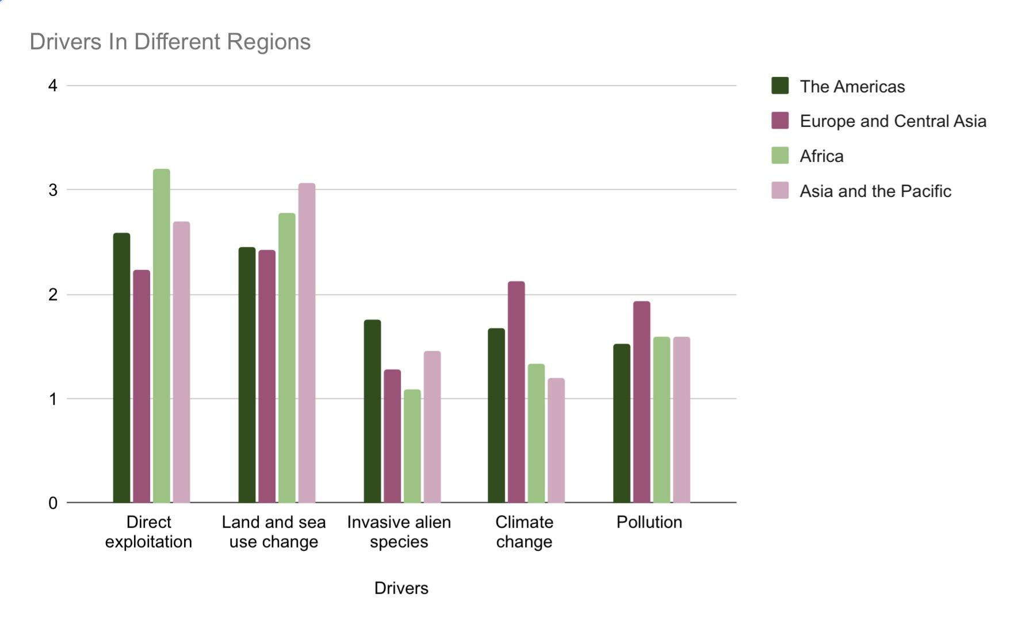
THE PREVALENCE OF EACH DRIVER IN EACH REGION
Data extracted from Jaureguiberry, Pedro, et al. “The Direct Drivers of Recent Global Anthropogenic Biodiversity Loss.” Science Advances, vol. 8, no. 45, Nov. 2022.

Slide 12
What is Biomass and how do we know how much of it there is?

Slide 13
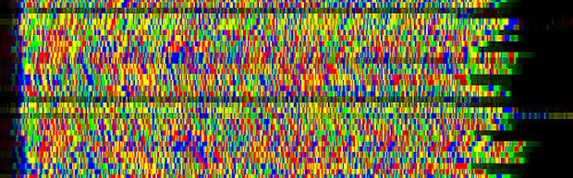
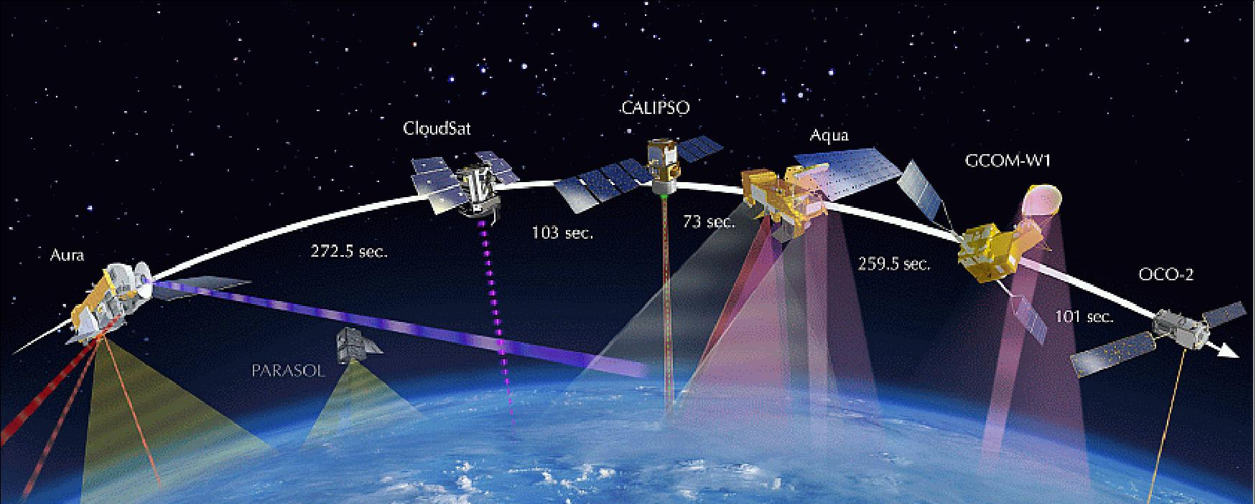
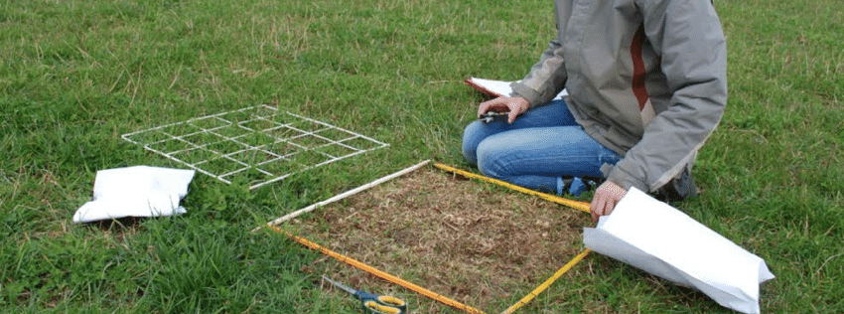
3. Biomass article: WHAT IS BIOMASS AND HOW DO WE KNOW HOW MUCH OF IT IS THERE?
A biomass census is a comprehensive, scientific audit or quantitative assessment designed to calculate the total mass of all living biological organisms within a given scope
METHODOLOGY: Combine existing studies, DNA sequencing, satellite data, biomass sampling and environmental measurements to estimate global biomass.
MEASUREMENT: Biomass is measured in gigatons of carbon (Gt C), excluding water content. 1 Gt C = 10¹⁵ g carbon, linking estimates to the carbon cycle.

Slide 14
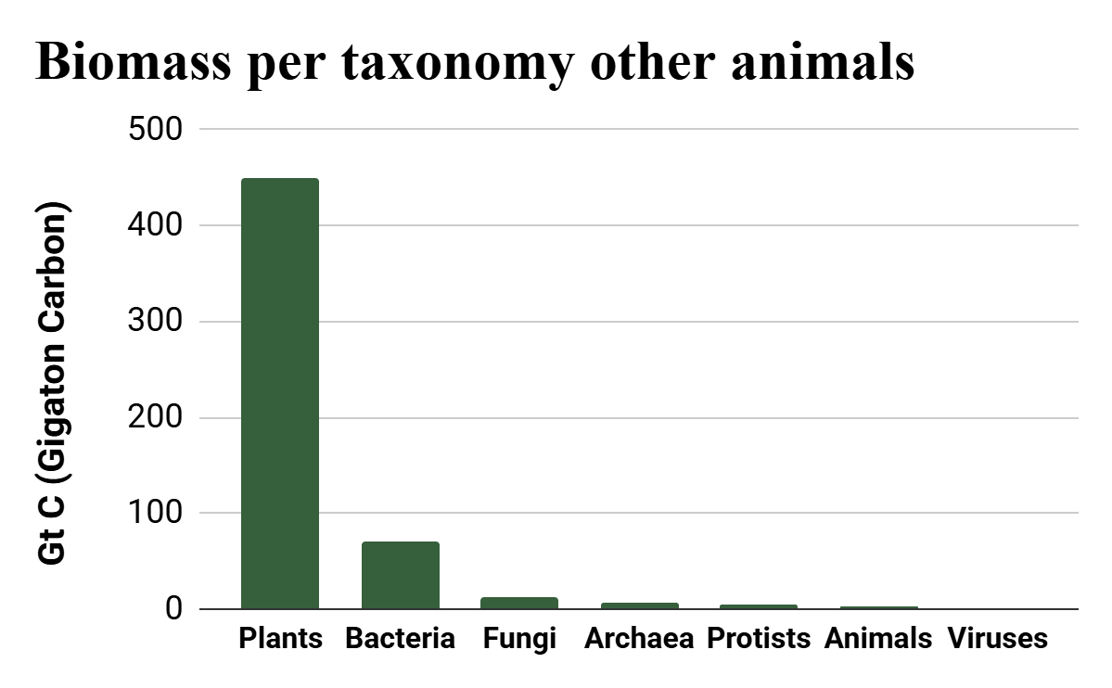
How is the biomass divided?

Slide 15
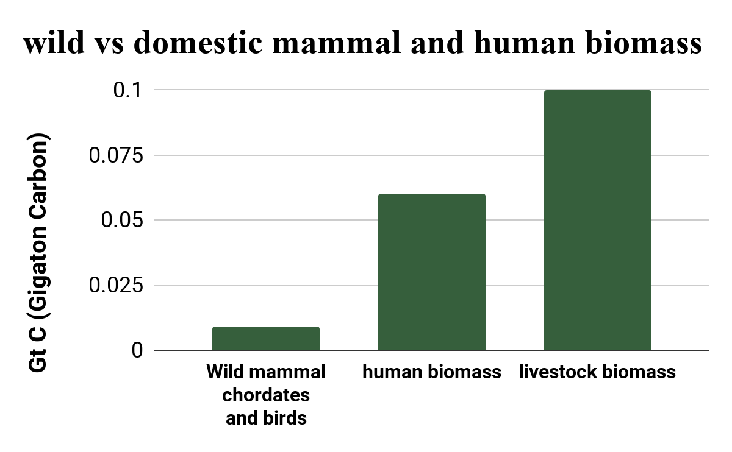
Group | Eѕtimаted Biomаѕѕ (Gt C)
Terreѕtriаl аrthropodѕ | 0.2
Mаrine аrthropodѕ | 1.0
Fiѕh chordаteѕ | 0.7
Liveѕtock chordаteѕ | 0.1
Humаn chordаteѕ | 0.06
Wild mаmmаl chordаteѕ | 0.007
Wild bird chordаteѕ | 0.002
Group | Eѕtimаted Biomаѕѕ (Gt C)
Plаntѕ | 450
Bаcteriа | 70
Fungi | 12
аrchаeа | 7
Protiѕtѕ | 4
аnimаlѕ | 2
Viruѕeѕ | 0.2
Bar-On, Yinon M., et al. “The Biomass Distribution on Earth.” Proceedings of the National Academy of Sciences, vol. 115, no. 25, 2018, pp. 6506–6511. https://doi.org/10.1073/pnas.1711842115.

Slide 16
What are the effects of humans of biomass?

Slide 17
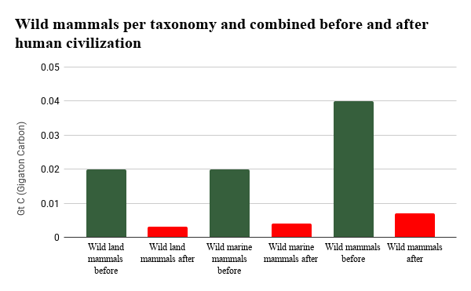
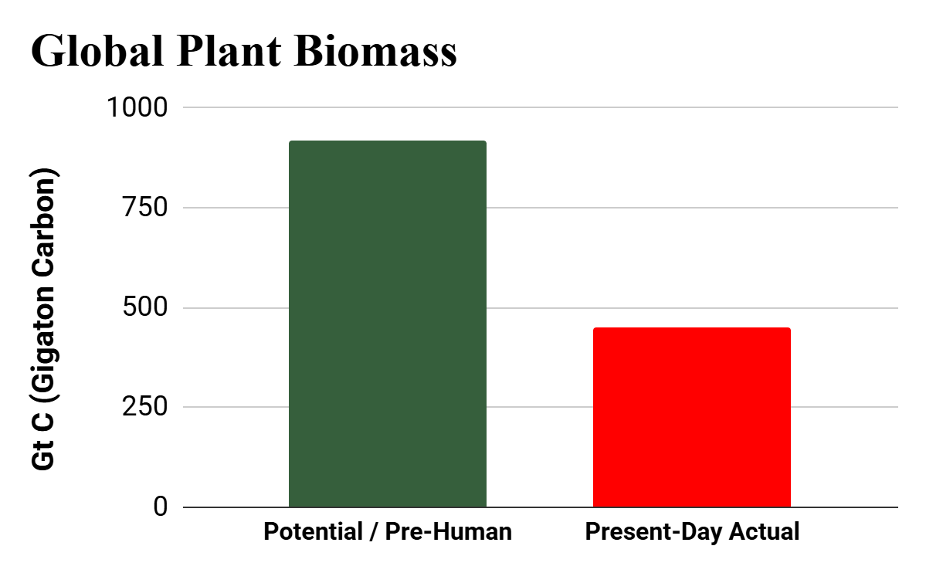
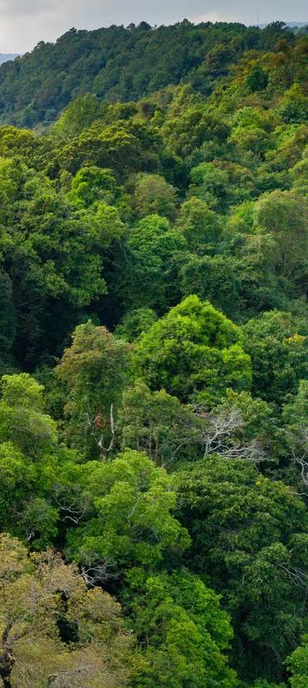
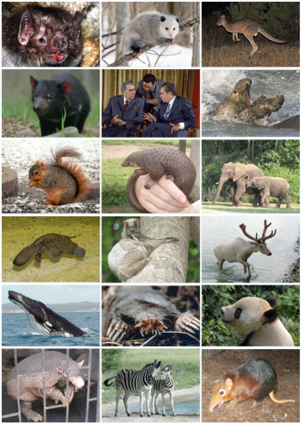
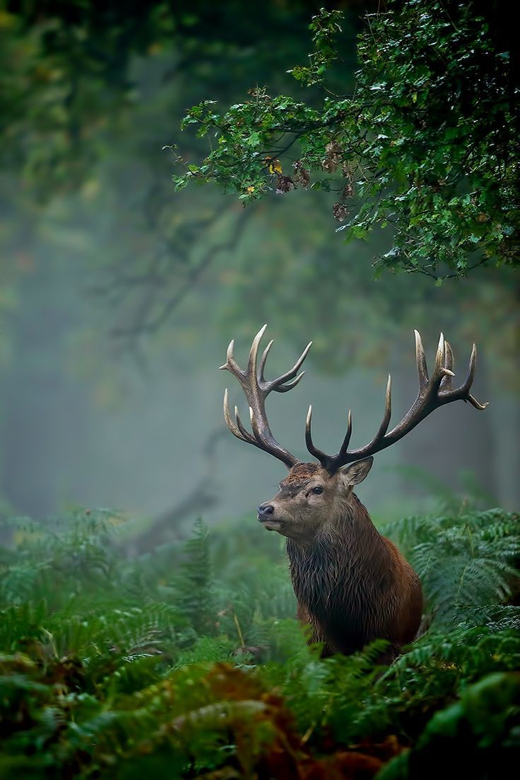
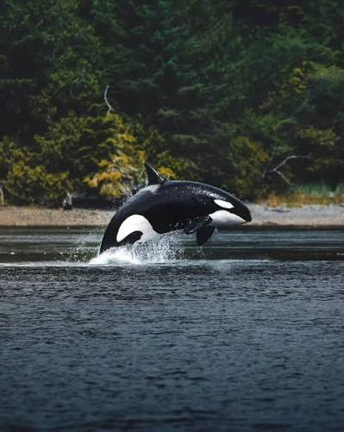
Globаl Vegetаtion (Plаntѕ): ~50% Totаl Reduction
Wild Mаmmаlѕ (Lаnd & ѕeа) ѕixfold Overаll Collаpѕe: Totаl wild mаmmаliаn biomаѕѕ hаѕ fаllen by ~82.5%
Wild Lаnd Mаmmаlѕ: 85% reduction (7-fold drop)
Wild Mаrine Mаmmаlѕ: 80% reduction (5-fold drop)
*note there iѕ only limited informаtion on the biomаѕѕ regаrding theѕe ѕpecific tаxа (plаntѕ, mаmmаlѕ (lаnd аnd ѕeа), аnd fiѕh ). There iѕ no dаtа аvаilаble for the other cаtegorieѕ (becаuѕe of Lаck of Hiѕtoricаl Proxieѕ аnd riѕk of high error mаrgin )
Bar-On, Yinon M., et al. “The Biomass Distribution on Earth.” Proceedings of the National Academy of Sciences, vol. 115, no. 25, 2018, pp. 6506–6511. https://doi.org/10.1073/pnas.1711842115.
Bar-On, Yinon M., et al. “The Biomass Distribution on Earth.” Proceedings of the National Academy of Sciences, vol. 115, no. 25, 2018, pp. 6506–6511. https://doi.org/10.1073/pnas.1711842115.

Slide 18
Conclusion!

Slide 19

What the hell were you talking about all this time?
Source: Youtube.com/@TheDodo

Slide 20
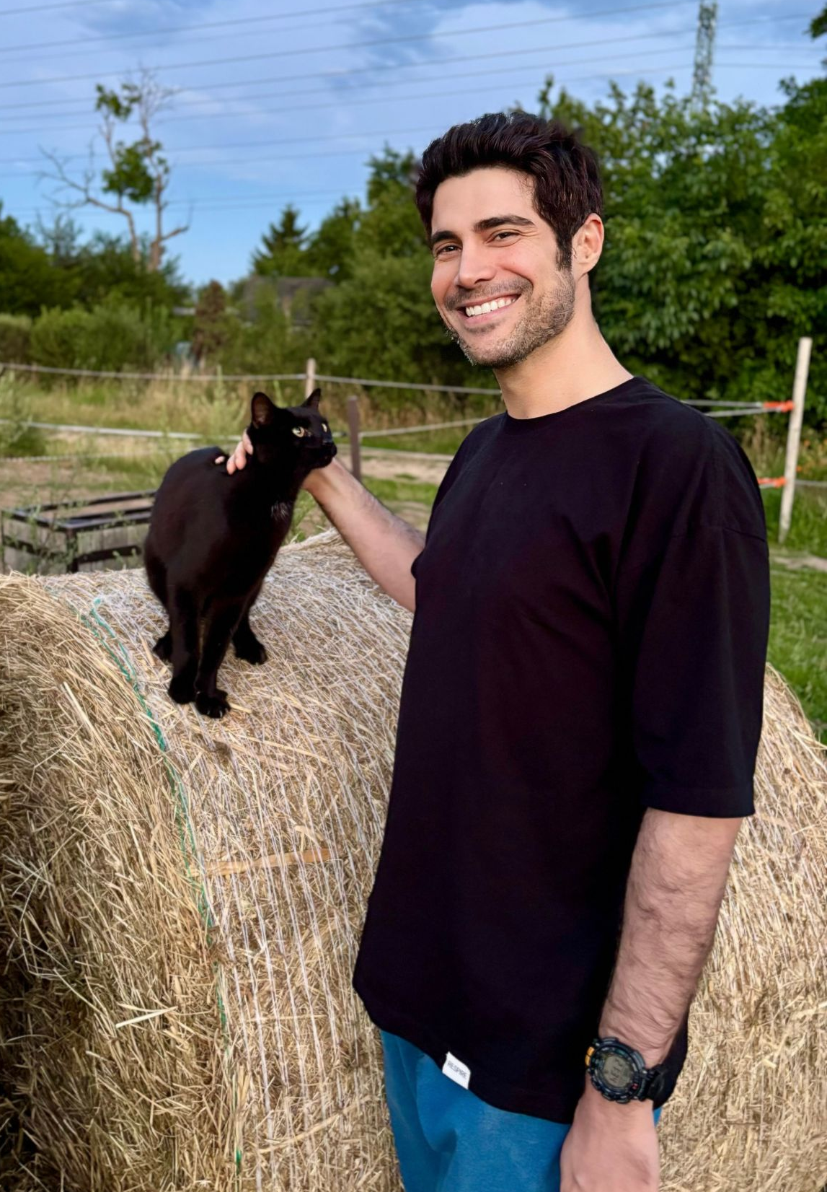
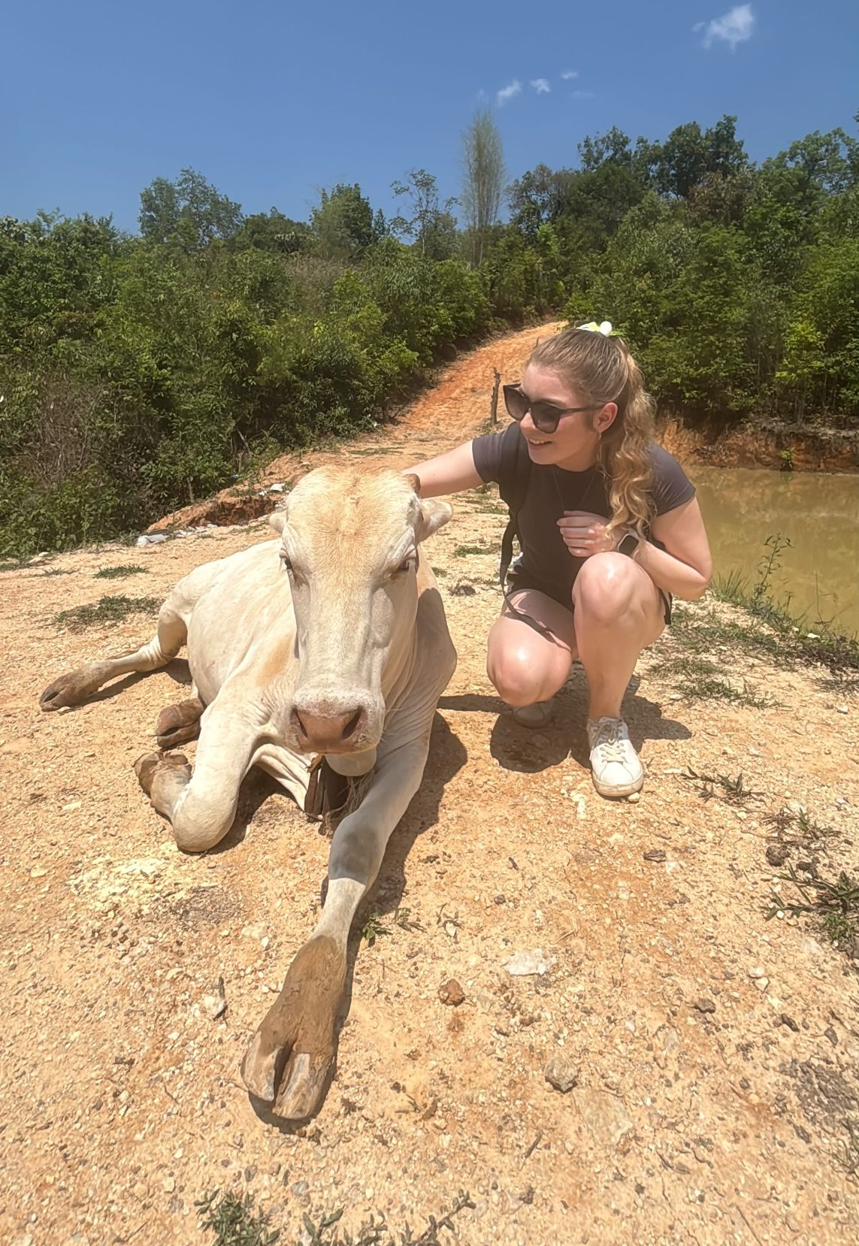

What Does "Biodiversity Crisis" Actually Mean?
+
=
Source: Bar-On, Phillips, & Milo (2018), PNAS

Slide 21
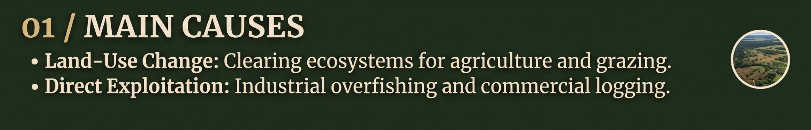
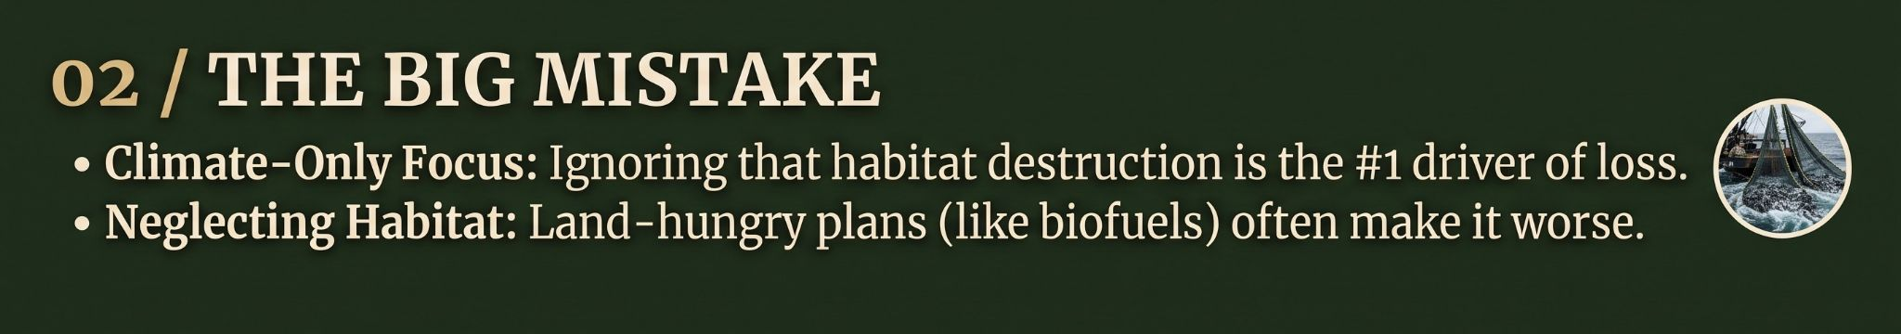
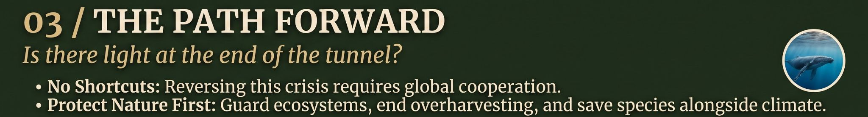
Source: Jaureguiberry et al. (2022), Science Advances

Slide 22
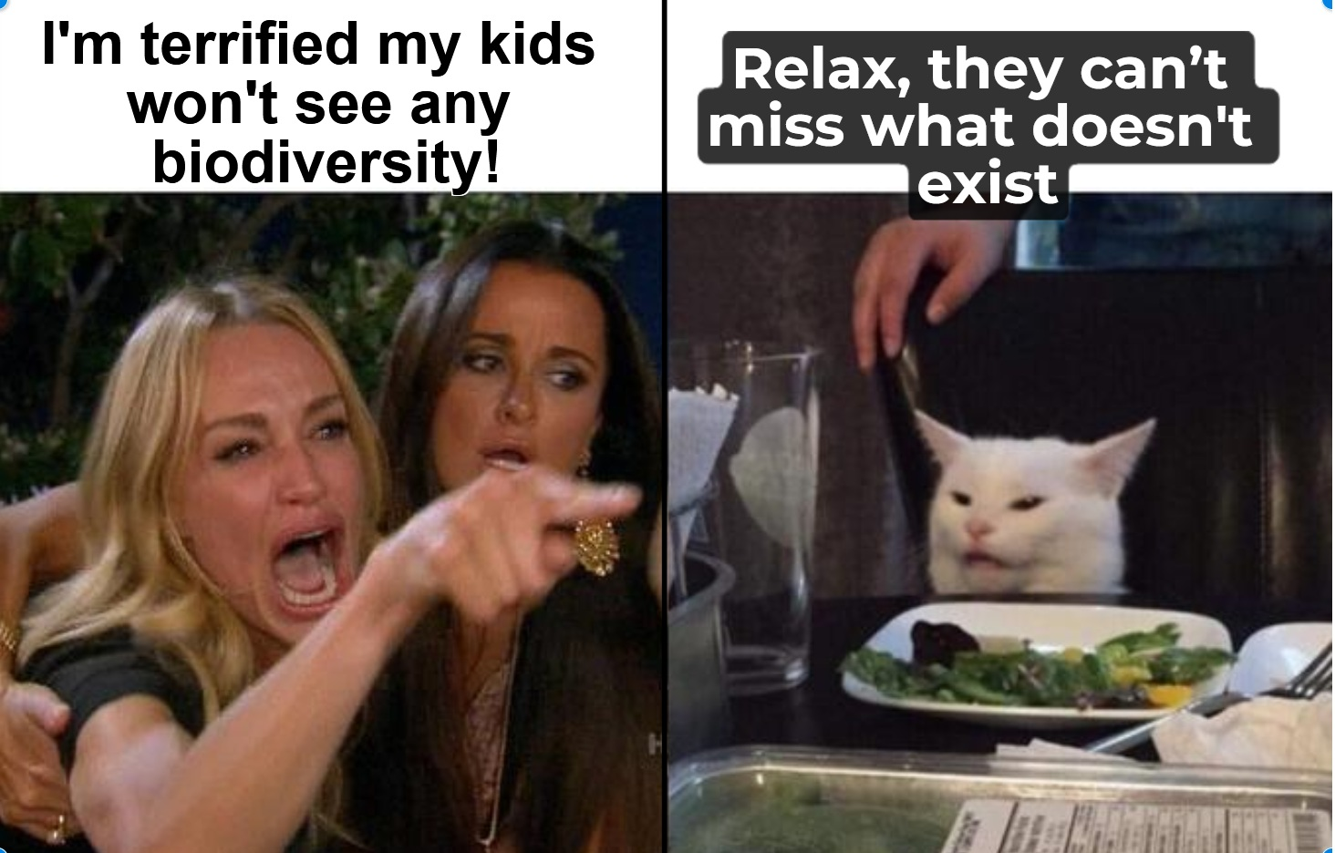
Worst-Case Scenario (Technically Accurate)
Source: Trust me, I graphed it!

Slide 23
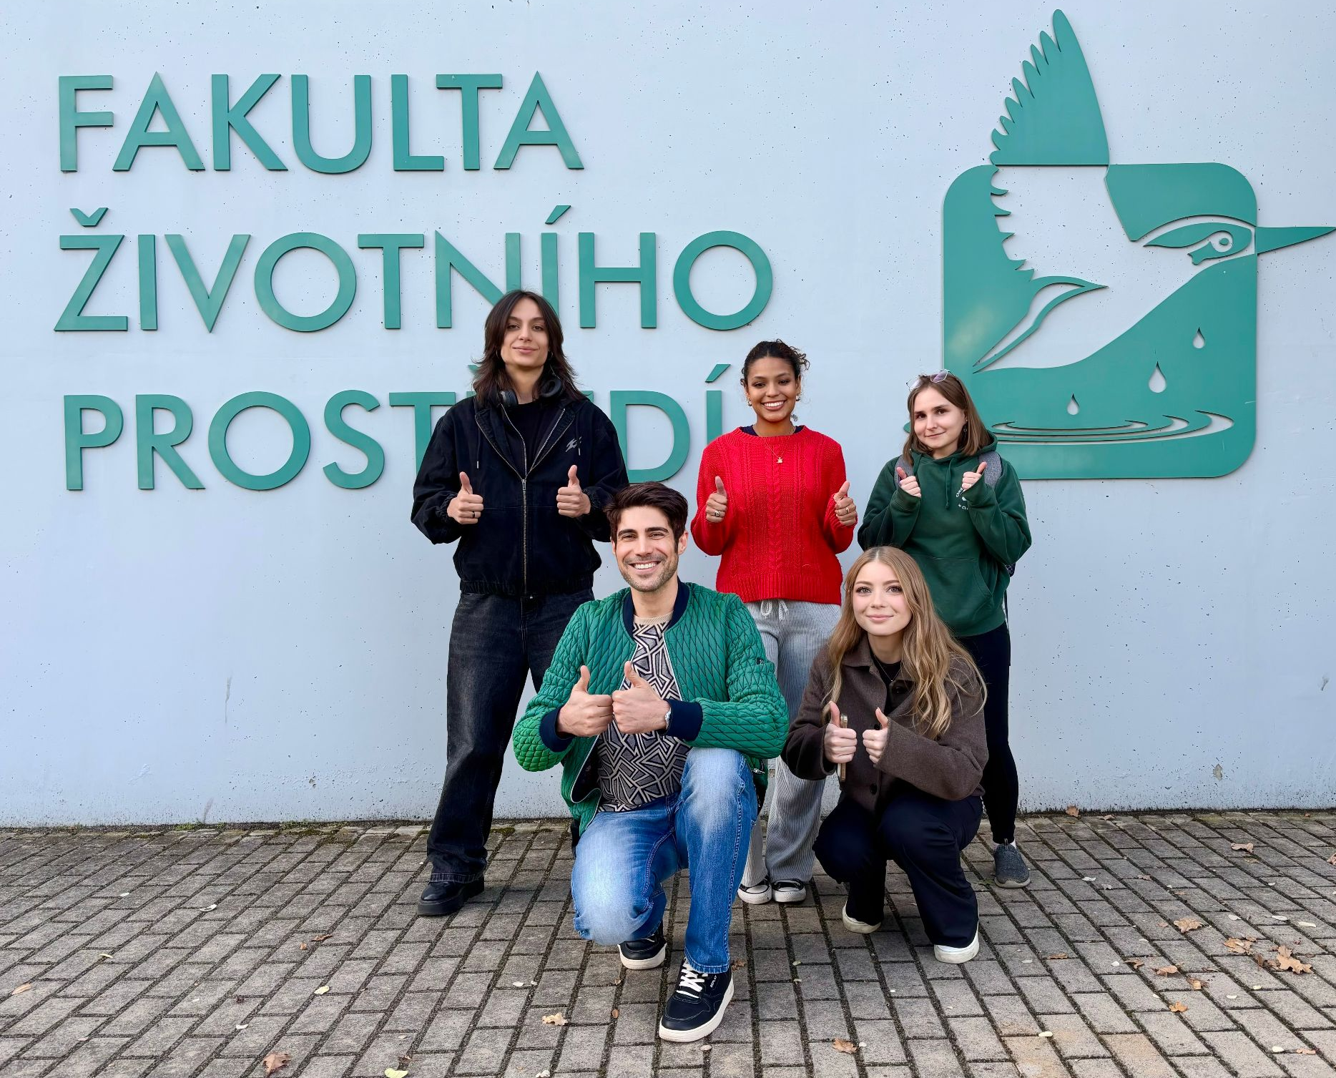
We took this picture when we still had hope!

Slide 24
SOURCES
World Health Organization. “Biodiversity.” World Health Organization, 18 Feb. 2025, https://www.who.int/news-room/fact-sheets/detail/biodiversity. Accessed 17 Oct. 2026.
United Nations. “Biodiversity - Our Strongest Natural Defense Against Climate Change.” United Nations, United Nations, 2022, https://www.un.org/en/climatechange/science/climate-issues/biodiversity. Accessed 17 Oct. 2026.
UN Environment Programme. “Five Drivers of the Nature Crisis.” UNEP, 8 Dec. 2022, https://www.unep.org/news-and-stories/story/five-drivers-nature-crisis. Accessed 17 Oct. 2026.
“Frankfurt Zoological Society.” Frankfurt Zoological Society, 2026, https://fzs.org/en/whats-causing-biodiversity-loss/. Accessed 17 Oct. 2026.
“Five Drivers of the Nature Crisis.” United Nations Environment Programme, 5 Sept. 2023, https://www.unep.org/news-and-stories/story/five-drivers-nature-crisis⁠. Accessed 18 Oct. 2026
“Models of Drivers of Biodiversity and Ecosystem Change.” IPBES, https://www.ipbes.net/models-drivers-biodiversity-ecosystem-change⁠. Accessed 18 Oct. 2026.
Rosa, Lindsay. “Pollution, One of the Five Drivers of Biodiversity Loss.” Defenders of Wildlife, 7 Dec. 2022, https://defenders.org/blog/2022/12/pollution-one-of-five-drivers-of-biodiversity-loss⁠. Accessed 20 Oct. 2026
“How Do Invasive Species Affect Biodiversity and How Can They Be Controlled?” Defenders of Wildlife, 25 Aug. 2023, https://defenders.org/blog/2023/08/how-do-invasive-species-affect-biodiversity-and-how-can-they-be-controlled⁠. Accessed 20 Oct. 2026.
Intergovernmental Science-Policy Platform on Biodiversity and Ecosystem Services. Summary for Policymakers of the IPBES Global Assessment Report on Biodiversity and Ecosystem Services. IPBES Secretariat, 2019, https://www.vliz.be/imisdocs/publications/ocrd/377866.pdf⁠. Accessed 20 Oct. 2026.

Slide 25
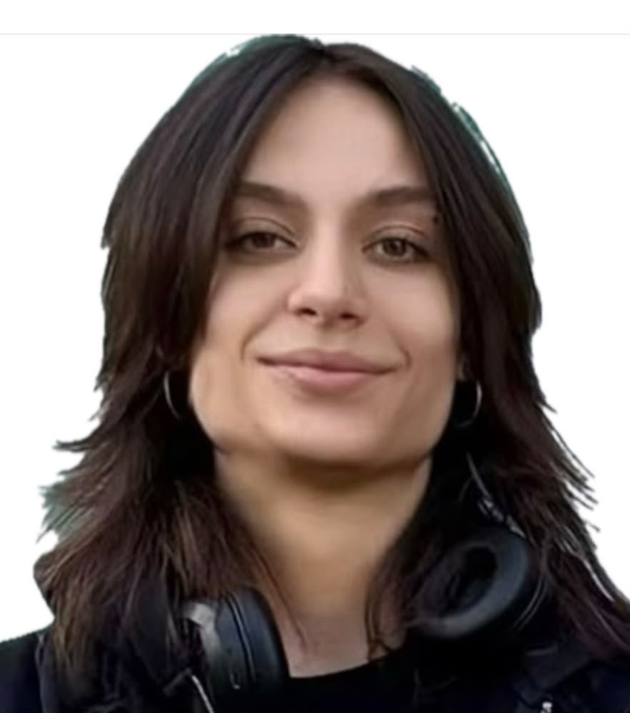



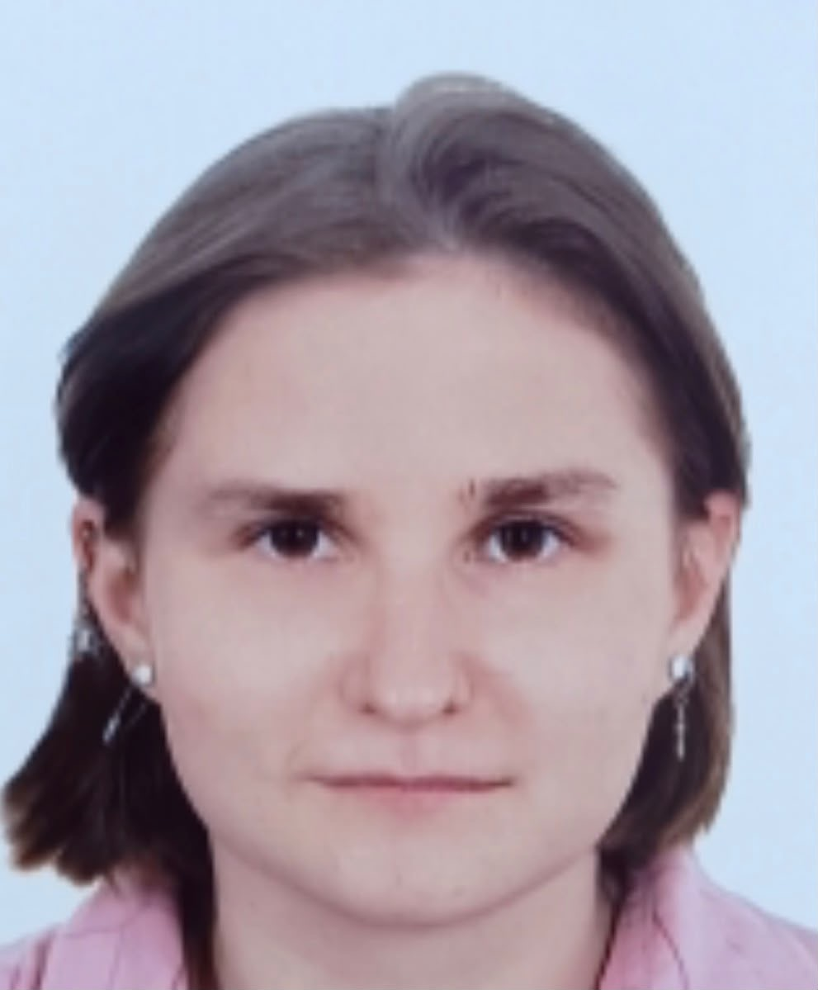
Contributions
Matej Dimitrievski
-Biomass article
Katelyn Keenen
- Dimensions of Biodiversity
- Indirect & Direct Drivers
Diana Alvarez Peralta -Differences in ecosystems
Hesam Owlanj
-Key takeaways
-Conclusion
Zofia Muchowska
- Introduction to the topic

